Slide 1



Course Name software Development project management
CSC 4125
(Undergraduate)
Chapter 10
Monitoring and Control
Software engineering (Undergraduate)
M. Mahmudul hasan
Assistant Professor, CS, AIUB
http://www.dit.hua.gr/~m.hasan

Slide 2
Why monitoring?
MMH
Once work schedules have been published and the project is under way, attention must be focused on ensuring progress.
This requires monitoring of what is happening, comparison of actual achievement against the schedule
Where necessary, revision of plans and schedules to bring the project as far as possible back on target.

Slide 3
framework
MMH
Start
Publish Initial Plan
Gather Project Information
End
Publish revised plan
Document conclusions
Compare progress vs. targets
Satisfactory ?
Take remedial action
Review
project
No
Yes
Project Completed ?
No
Yes
End Project

Slide 4
responsibility
MMH
Steering Committee
client
Project Manager
Team Leader
Team Leader
Team Leader
Team Leader
Analysis/Design
section
Programming
section
Quality control
section
User
Documentation
section

Slide 5
Assessing Progress
MMH
Report type | Examples | Comment
Oral formal regular | Weekly or monthly progress meetings | While reports may be oral formal written minutes should be kept
Oral formal ad hoc | End-of-stage review meetings | While largely oral, likely to receive and generate written reports
Written formal regular | Job sheets, progress reports | Normally weekly using forms
Written formal ad hoc | Exception reports, change reports
Oral informal ad hoc | Canteen discussion, social interaction | Often provides early warning; must be backed up by formal reporting

Slide 6
Assessing Progress
MMH
Slide-6
Setting checkpoints
It is essential to set a series of checkpoints in the initial activity plan.
Checkpoints may be: Regular (e.g. monthly)
Tied to specific events such as the production of a report or other deliverable (milestone)
Taking Snap-Shots
Team leaders need to assess progress daily
Project managers find weekly or monthly reporting appropriate
The higher the level, the less frequent and less detailed the reporting needs to be

Slide 7
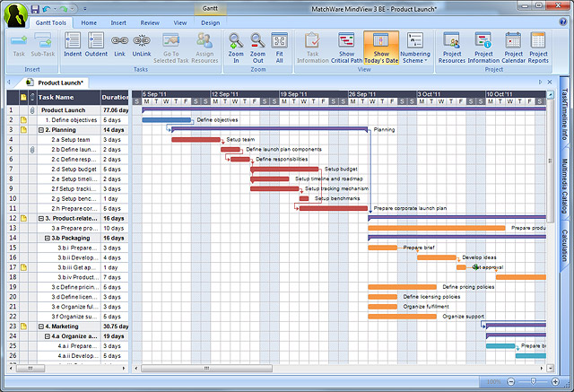
Visualizing progress – gantt chart
MMH
Slide-7
An activity bar chart indicating scheduled activity dates and durations
Reported progress is recorded on the chart and ‘today cursor’ provides an immediate visual indication of which activities are ahead and behind schedule
Fig1: Gantt chart

Slide 8
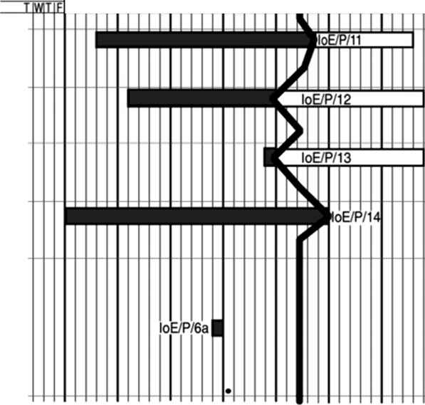
Visualizing progress – slip chart
MMH
Slide-8
It provides a striking visual indication of those activities that are not progressing to schedule (late) – the more the slip line bends, the greater the variation from the plan
Fig2: Slip chart - Emphasizes the relative position of each activity in a specific week

Slide 9
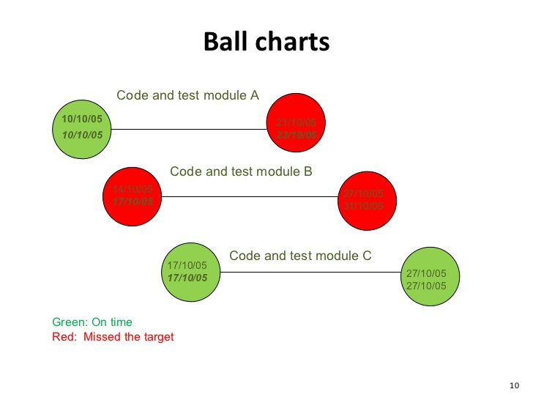
Visualizing progress – ball chart
MMH
Slide-9
A more striking way of showing whether or not targets have been met is to use a ball chart
The circles indicate start and completion points for activities
Fig3: Ball chart

Slide 10
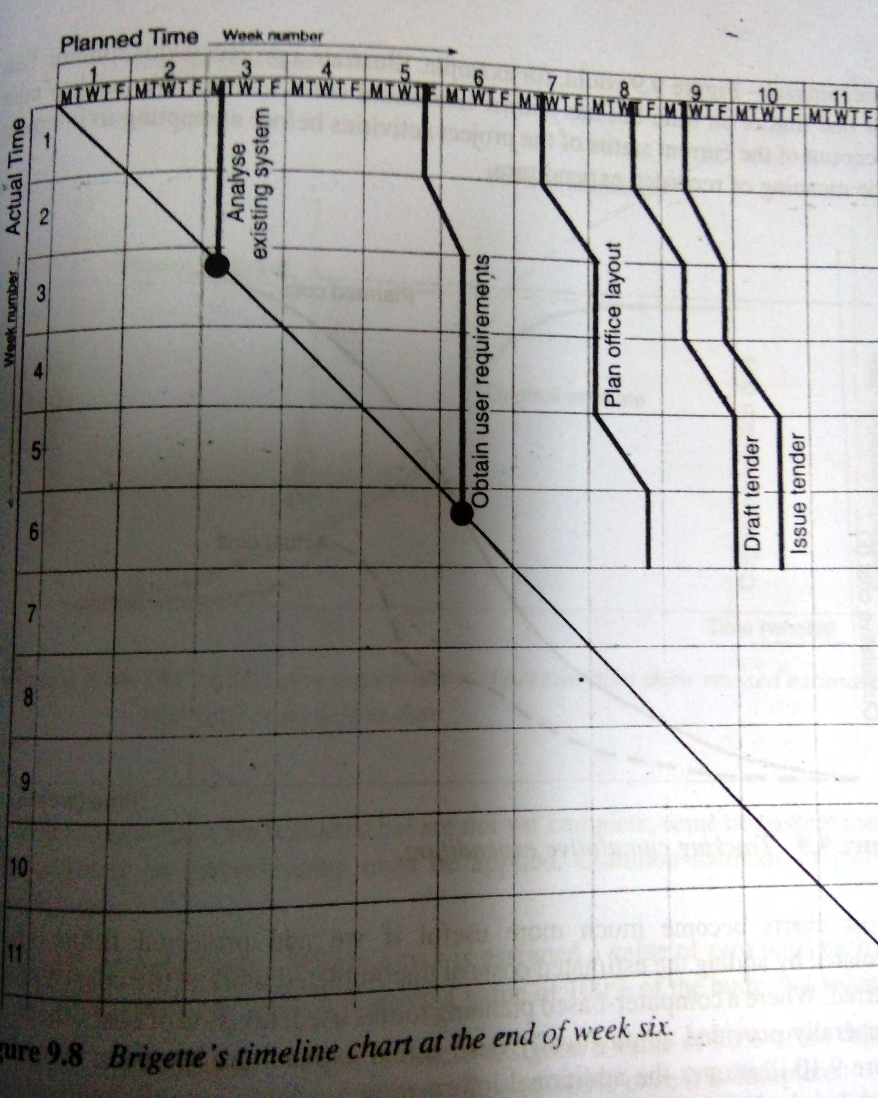
Visualizing progress – timeline chart
MMH
Slide-10
Planned time is plotted along the horizontal axis and elapsed time down the vertical axis
Fig4: Timeline chart

Slide 11
EVA exercise
MMH
Slide-11
Assume you are a software project manager and you’ve been asked to compute earned value statistics for a small software project.
The project has 56 planned work tasks that are estimated to require 582 person-days to complete.
At the time that you’ve been asked to do the earned value analysis, 12 tasks have been completed.
However the project schedule indicates that 15 tasks should have been completed.
The following scheduling data (in person-days) are avalable:

Slide 12
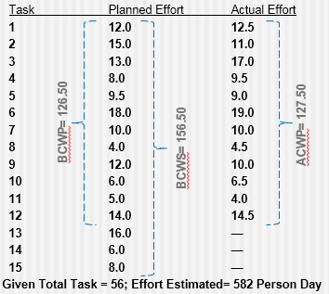
EVA exercise
MMH
Slide-12
BAC = 582.00
SPI = BCWP/ BCWS = 126.5/ 156.5 = 0.808307
SV = BCWP - BCWS = 126.5 - 156.5 = -30 person-day
% schedule for completion = BCWS/ BAC = 156.5/ 582.00 = 26.89%
[% of work scheduled to be done at this time]
% complete = BCWP/ BAC = 126.5/ 582.00 = 21.74% [% of work completed at this time]
CPI = BCWP/ ACWP = 0.99
CV = BCWP – ACWP = -1 person-day

Slide 13
Prioritizing monitoring
MMH
Slide-13
Critical path activities – any delay in an activity on the critical path will cause a delay in the completion date for the project
Activities with no free float – a delay in any activity with no free float will delay at least some subsequent activities even though, if the delay is less than the total float , it might not delay the project completion date. These subsequent delays can have serious effect on our resource schedule as a delay in a subsequent activity could mean that the resources for that activity will become unavailable before that activity is completed because they are committed to elsewhere
Activities with less than a specified float – if any activity has very little float, it might use up this float before the regular activity monitoring brings the problem to the project manager’s attention. It is common practice to monitor closely those activities with less than one week free float

Slide 14
Prioritizing monitoring
MMH
Slide-14
High risk activities – a set of high risk activities should have been identified as part of initial risk profiling exercise which will give close attention because they are most likely to overrun or overspend
Activities using critical resources – Staff or other resources might be available only for a limited period, especially if they are controlled outside the project team. In any event, an activity that demands a critical resource requires a high level of monitoring

Slide 15
Getting the project back to target
MMH
Slide-15
Shorten the critical path – shorten the timescale for critical activities by putting experienced programmer should be significantly more productive than a more junior member of the team
Reconsider the precedence requirements – alter normal planned practice to start prerequisite requirements as earlier as possible

Slide 16
references
MMH
Bob Hughes and Mike Cotterel (1999). Software Project Management (Second Edition).
PMBOK Guide: Project Lifecycle (5th Edition)

